Slide 1
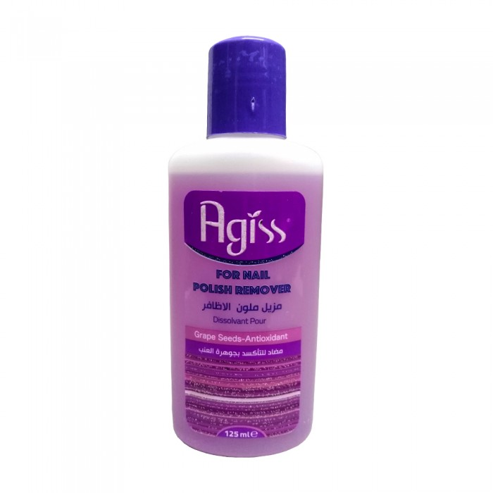
Agis
Agis Anti-Oxidant Nail Polish Remover 125 ml
11.50 SAR Q
It is necessary to have it in the manicure set, the 125ml antioxidant nail polish remover from Agis not only removes nail polish and decorations from your nails immediately, but also nourishes your nails and the skin surrounding them. Enriched with grape seed oil, the product moisturizes and strengthens nails and skin. It also increases the elasticity of nails and makes them healthy and beautiful and maintains the natural nail color. High-efficiency acetone-free formula removes all traces of former nail polish and leaves a nice smell too.

Slide 2
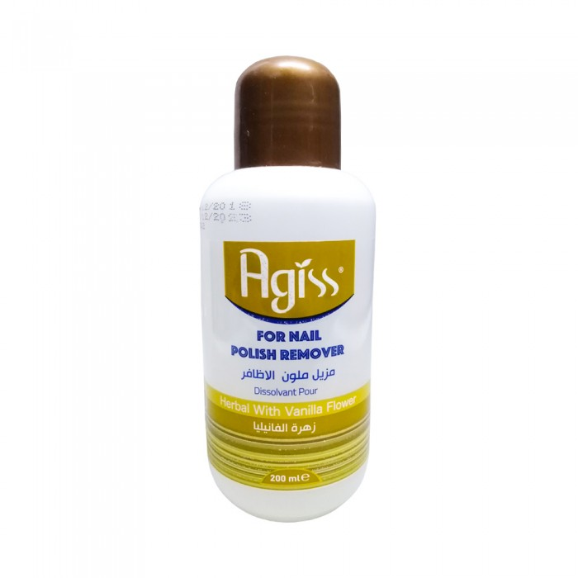
Agis
Agis nail polish remover vanilla 200ml
23.00 SAR. Q
Nail colors add a sense of style to shaving, but removing the product can be boring. The nail polish remover from Agis is the saviour. Agis nail polish remover has a light and soothing vanilla scent. The product effectively removes nail polish on natural nails and acrylic, while feeding the nail layer and skin. The product formula is a clinically approved acetone-free formula that easily removes multi-layered nail gloss and coating. Nail polish remover leaves no leftover enamel. It is lightweight and safe

Slide 3
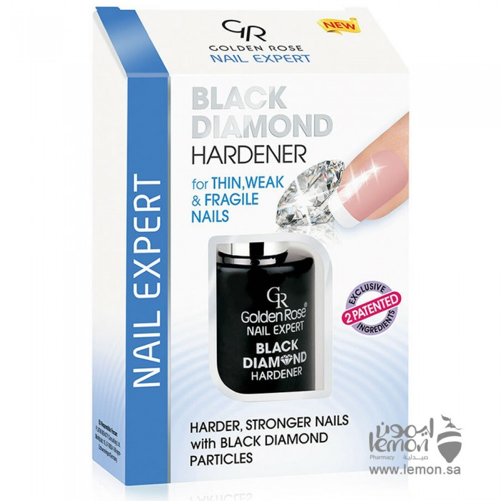
Black Diamond Diamond Nail Reinforcer From GR Neil Xpert 11ML
30.19 SAR. Q
Black Diamond diamond nail reinforcer from GR Neil Expert for stronger nails with black diamond particles. Its patented double ingredients of small diamond particles and sclerosis factor. Instantly enhances thin, weak and fragile nails by building a shiny protective shield. The fast-drying GR diamond nail booster helps prevent cutting, breaking and splitting nails after 4 weeks of regular use.

Slide 4
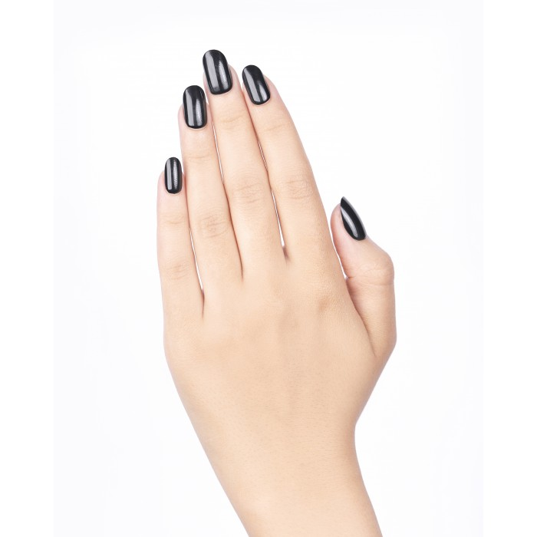
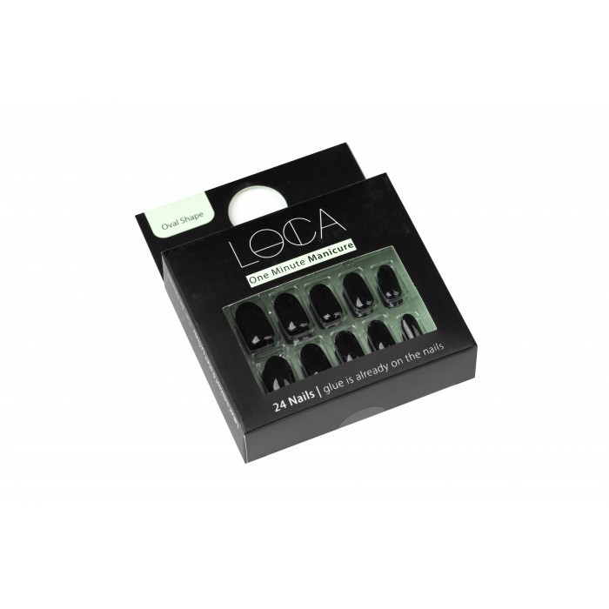
Luca
Luca Nail Synthetic Self Paste - Black Glossy Shape Oval 24 Pieces
41.63 SAR. Q
Luca synthetic self-adhesive nails ensures you get perfect nails within a very short time. These nails already have adhesive so you can quickly apply them without any mess. Luca's nails come in a stylish and cool finish enough to meet your demands. Luca's nail colors are unique so that they fit perfectly into any clothes.

Slide 5
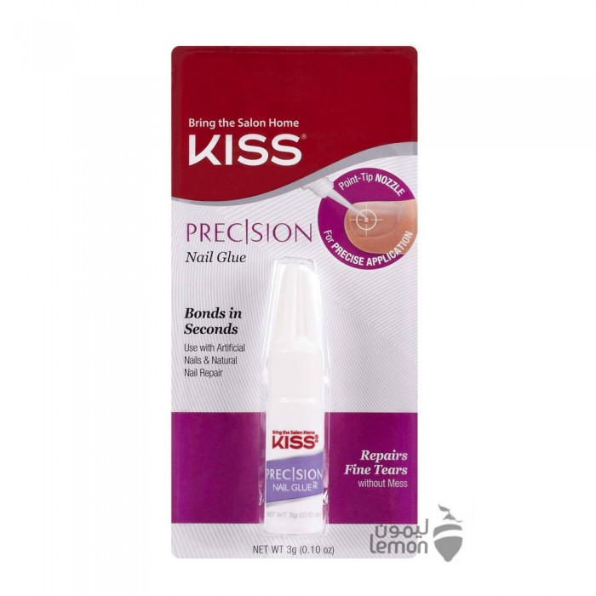
Nail Polish Precision of Bag
33.35 SAR. Q

